Slide 1
Advertising Content and
Consumer Engagement
on Social Media
Return Rates Researchers
Rebecca Melo, Ngoc-Tran Nguyen, Hinley Fung and Stephanie Thurstone

Slide 2
Table of contents
1
2
3
4
5
6
Motivation & Summary
Questions & Data
Data Cleanup & Exploration
Data Analysis
Discussion
Post Mortem

Slide 3
Hypothesis
Define advertisement engagement based on demographics through social media platforms and identify the highest and lowest return rates and economic effect of targeted marketing.
Notes:
Motivation & Summary Slide
Define the core message or hypothesis of your project.
Describe the questions you asked, and why you asked them
Describe whether you were able to answer these questions to your satisfaction, and briefly summarize your findings

Slide 4
Questions & Why
Question 1: What are the key targets for specific social media platforms? What demographics are engaging the most? I.e Age, gender, location, etc.
Question 2: When are click rates peaking? What time of year/day are they most prevalent? Is there a relation to current events/pop culture?
Question 3: What is average exposure rate per click vs. purchase?
Question 4: What social media platforms are most successful in gaining return on investment via click rates?
Notes:
Motivation & Summary Slide
Define the core message or hypothesis of your project.
Describe the questions you asked, and why you asked them
Describe whether you were able to answer these questions to your satisfaction, and briefly summarize your findings

Slide 5
What Data Can Answer These Questions?
Question 1: key targets & demographics I.e Age, gender, location, etc.
Social-influence-on-shopping.csv → This data is a survey with 300,000 millennial and Gen Z members describing what percentage of certain social media platforms have influenced their online shopping most based on gender, race, location, schooling, jobs, parents income, etc.
KAG_conversion_data → looks into three Facebook campaign ads and how well the companies performed. Based the demographic of age, interest and gender.
Facebook_Ads_2.csv→ Analyzes the amount of participant engagement of Facebook Ad campaigns based on time spent on site, salary and, clicks.
Question 2: Click rates vs. time of year/day. Relation to current events/pop culture?
Twitter API → Twitter's open, global, real-time and historical communication network provides tools, resources, and data through API keys to integrate and expand Twitter's impact through research. Tweets are pulled in real-time to see what type of ads are being displayed by day/time, #of likes and retweets they get, etc.
Question 3: What is average exposure rate per click vs. purchase?
Facebook_Ads_2.csv → Analyzes the amount of participant engagement of Facebook Ad campaigns based on time spent on site, salary and, clicks.
Question 4: What social media platforms are most successful in gaining return on investment via click rates?
Social_Network_Ads(1).csv → Analyzes the amount of participant engagement of Social Network Ad Campaigns based on gender, age, salary and purchases.
Notes:
Elaborate on the questions you asked, describing what kinds of data you needed to answer them, and where you found it

Slide 6

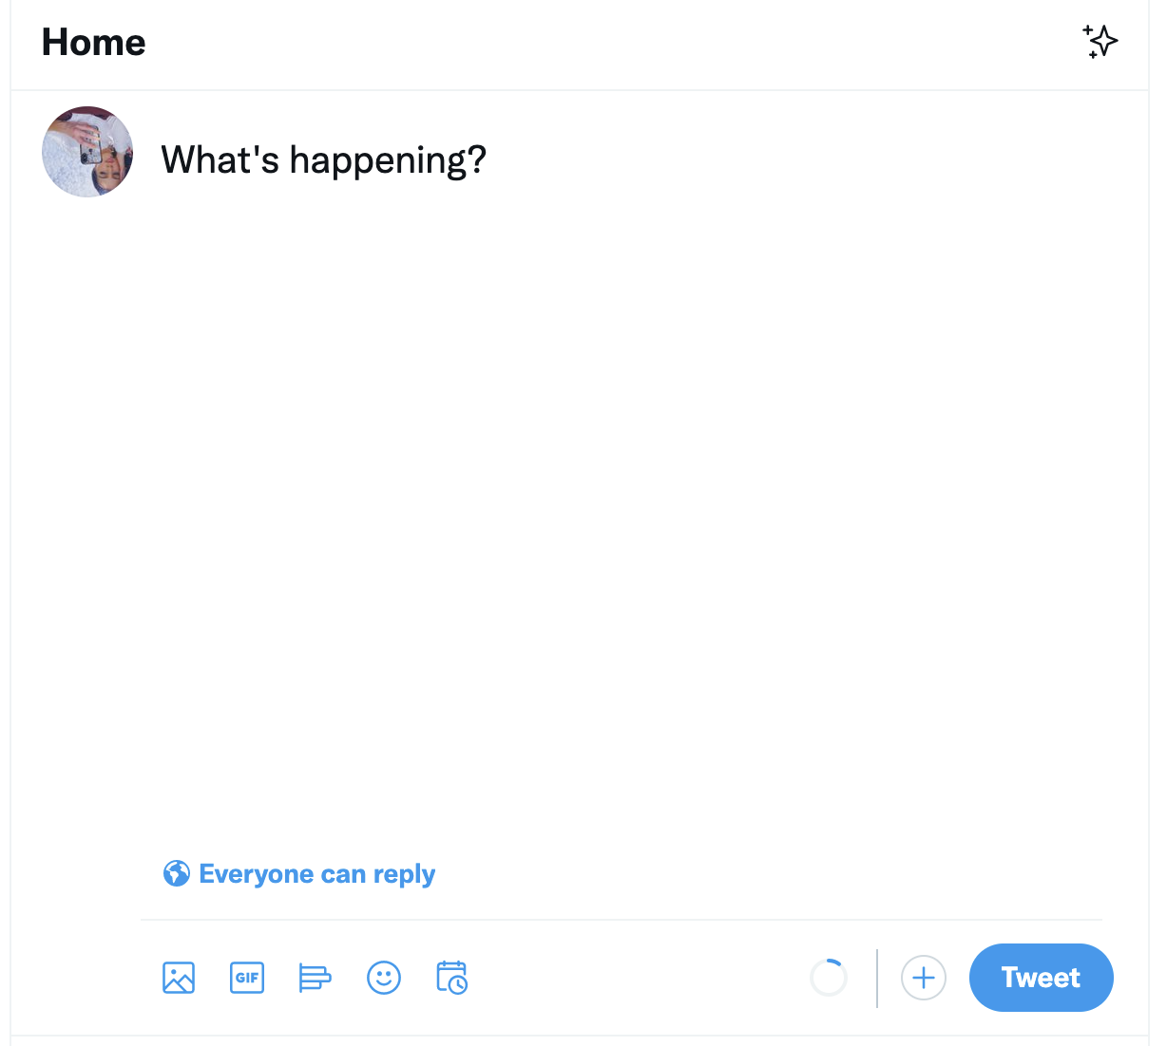
Summary of Analysis
Return Rate Researchers were successful in their efforts to develop conclusions to support their hypothesis and answer the majority of presented research questions. The key targets for Facebook and Twitter are mainly Gen-Z and Millennials and gender does not seem to play a large role in return on investment. Retweets (click rate) peak around 9:37 PM. The average exposure rate per click vs. purchase is 32.92 minutes and Facebook seems to have the largest return on investment based on the data studied.

Slide 7
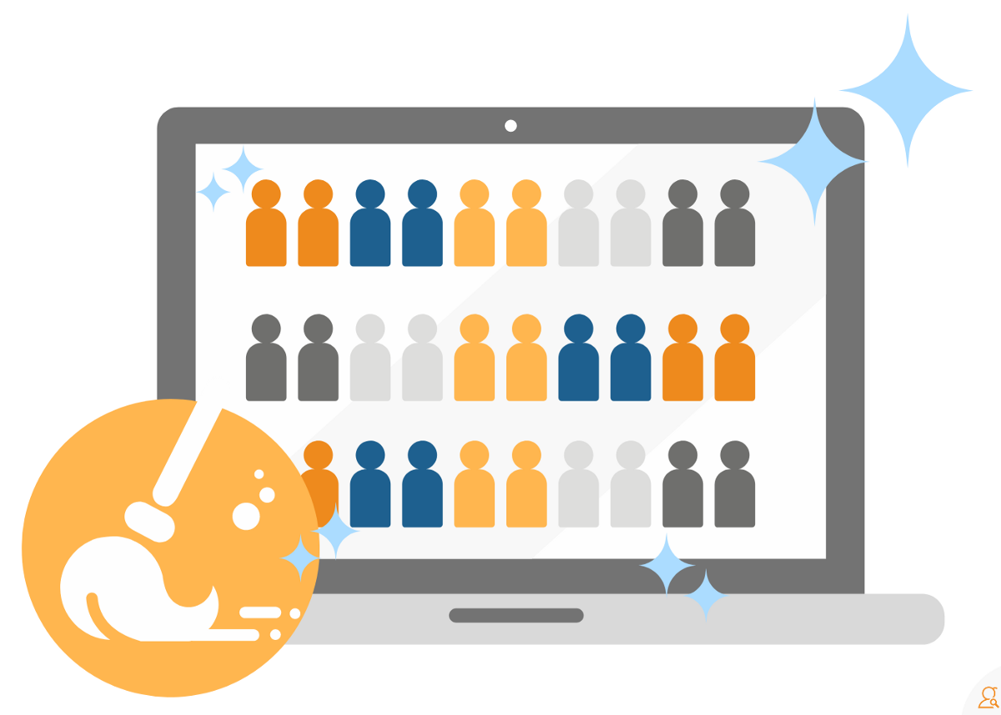
Data Cleanup & Exploration
Twitter API - multiple dictionaries within the json
This needed extra time to figure out how to pull the dictionaries into dataframes and merge the data together
API could only pull the 100 most recent tweets based on #Ad. Restrictions of 15 minute intervals. To get a lot data, this would need to run every 15 minutes per day.
Some of the datasets (from places like Kaggle.com), were easy to understand and put together. Other datasets had information that was hard to identify when analyzing, including but not limited to:
Unknown fields with little to no information on definitions within the datasets
Fields called “none”-- but what is none and how is it defined?
Getting rid of other datasets we wanted to use due to a pay wall
or lack of public information from companies and how successful their ads run on social media platforms
Notes:
So the data analysis started out with cleaning the data. First off, I personally started looking at Twitter’s API. I will show my notebook after this slide, but you will see that the data I get when querying the most recent 100 tweets had a lot of dictionaries within dictionaries. The query pull could also only be run every 15 minutes. You get a lot of information, but this would need to be fun every 15 minutes every day throughout the week. Since extracting multiple dictionaries data from the json was time consuming on our end, our data only consists of one day’s worth of tweets from a specific time frame.
Besides the Twitter API, the rest of our datasets --like from Kaggle-- were relatively easy to put together dataframes and analyze. Some issues we ran into were that some of the data had unknown fields with little to no information on definition of keys within the datasets. Tran will go over this point in her slide with the data field “none”.
In addition, we could have gotten more information but a lot of the data was behind a paywall or these companies withhold any information to public of their advertising analytics.
Data Cleanup & Exploration
Describe the exploration and cleanup process
Discuss insights you had while exploring the data that you didn't anticipate
Discuss any problems that arose after exploring the data, and how you resolved them
Present and discuss interesting figures developed during exploration, ideally with the help of Jupyter Notebook

Slide 8
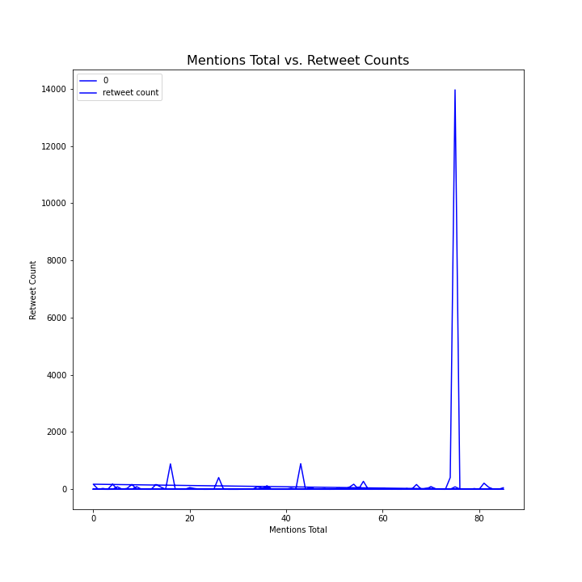
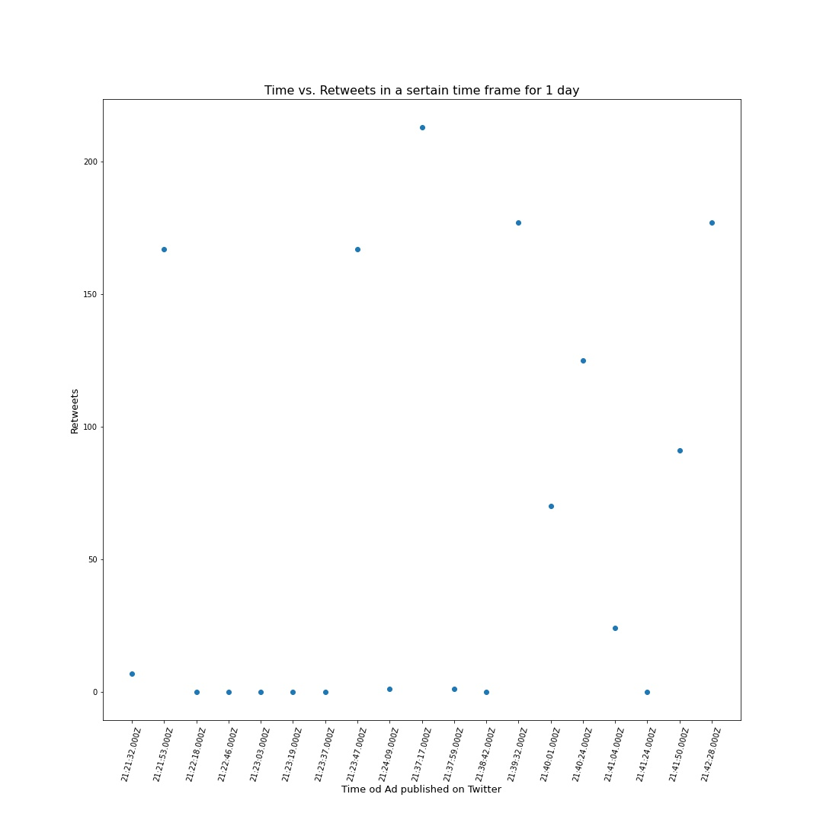
Rebecca’s Discovery
Some correlation between the amount of retweets as the day progresses. At around 9:40pm, there is a spike in retweets in ads.
The caveat of this data is that I did not have time to run this API multiple times on multiple days to get a large sample size.
The more number of mentions of that your ad gets, the more retweets of your original #ad post
This means that more people will see your ad on Twitter and engage in your post.
Notes:
Most people use Twitter either on the App (phone), actual webpage (Twitter.com), others are far and few inbetween.

Slide 9
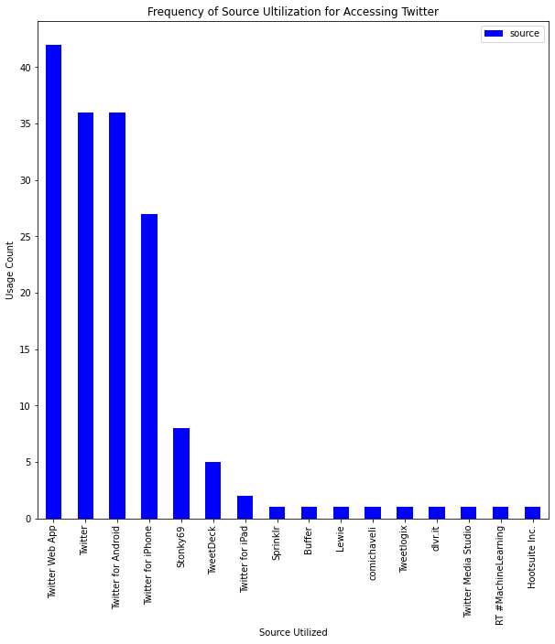
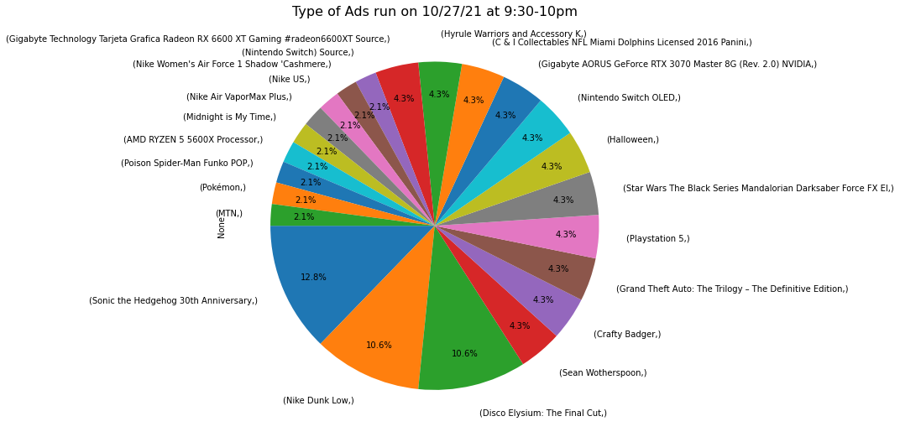
Sonic the Hedgehog 30th Anniversary (video game) ad was most prevalent at the time with 12.8% (6 counts of ads from that span of time in the data set).
Nike Dunk Low (type of shoe) and Disco Elysium: The Final Cut (video game) were a close second at 10.6% (5 counts of ads in that span of time in the dataset).
The rest of the types of ads varied, around 1 to 2 counts of ads.
The most frequently utilized source is the Twitter Web App.
Notes:
Most people use Twitter either on the App (phone), actual webpage (Twitter.com), others are far and few inbetween.
A lot of the ads seem to be video game related, and I would make the conclusion that these specific companies are trying to target a certain demographic for this hour of time -- likely people who play video games that they believe would be on Twitter around 9-10pm.
the Gen-Z and Millennial generations

Slide 10
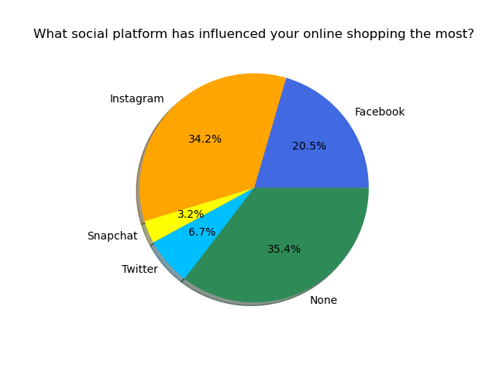
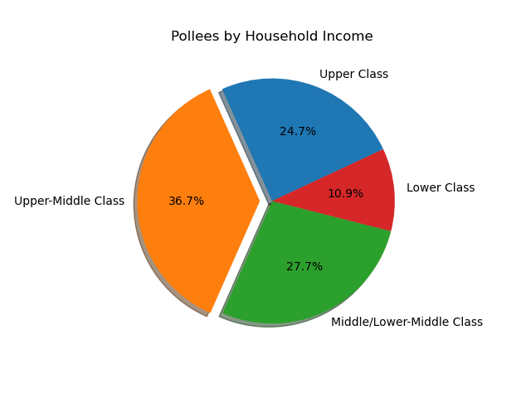
Tran’s Discovery
Notes:
What is “none”???
Ads on other platforms
Don’t use social media accounts (only for professional purposes)
Don’t click on ads
Demographic info doesn’t tell us much about individuals’ spending habits - we can make generalizations based on income, but the income provided in this particular survey is the pollee’s parents’, not their own
Sample size: 2676

Slide 11
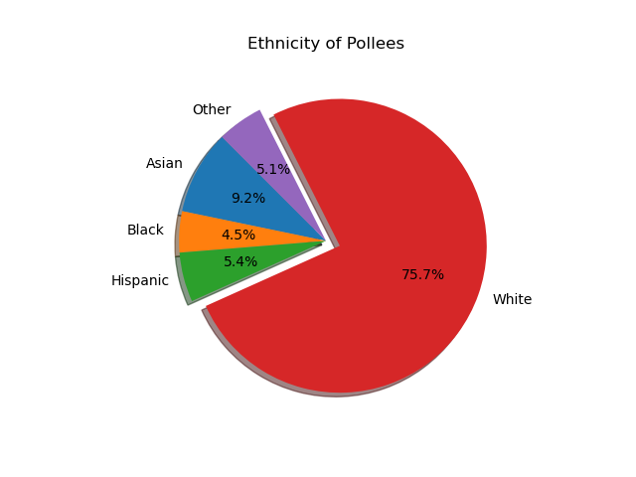
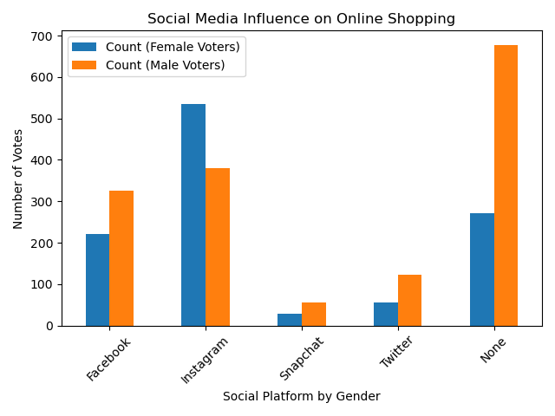
Limitations of this data:
not an accurate representation of US population
Notes:
Limitations: pie chart isn’t an accurate representation of US population

Slide 12
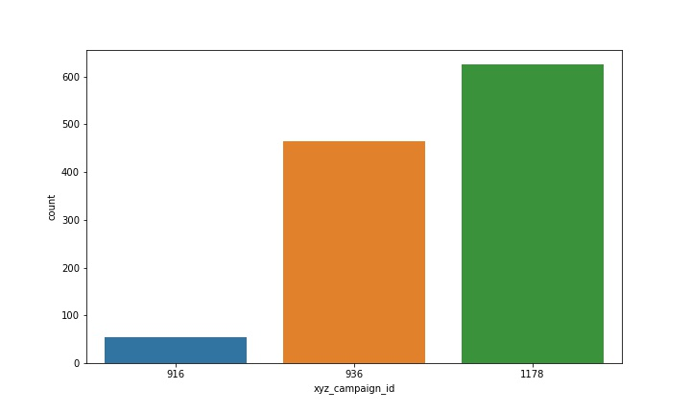
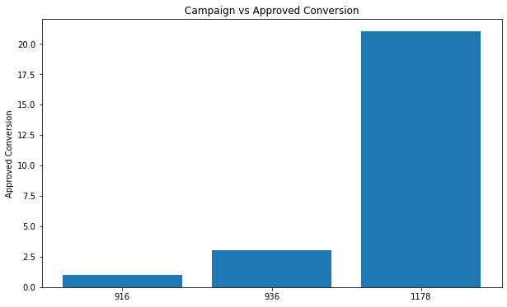
Hinley’s Discovery
How many ads did each campaigns ran
How successful was each campaign on getting users to make purchase
Notes:
Total ads 1143 shown,
The more ads a company shows to users the higher chances they are likely to have clients make purchases

Slide 13
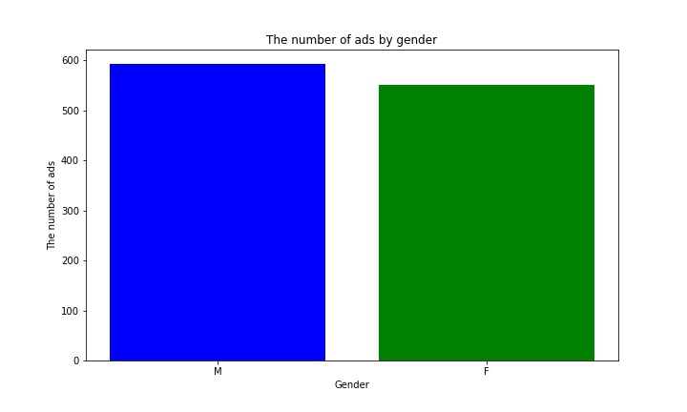
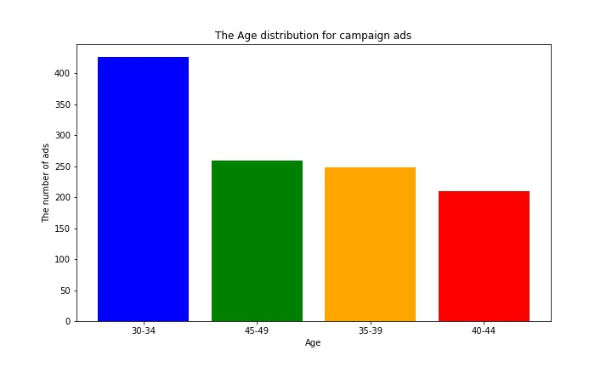
Data on Age and Gender
Gender has no influence as both male and females see the ads equally
Users in the age range of 30-34 are the most likely influenced by the ads

Slide 14
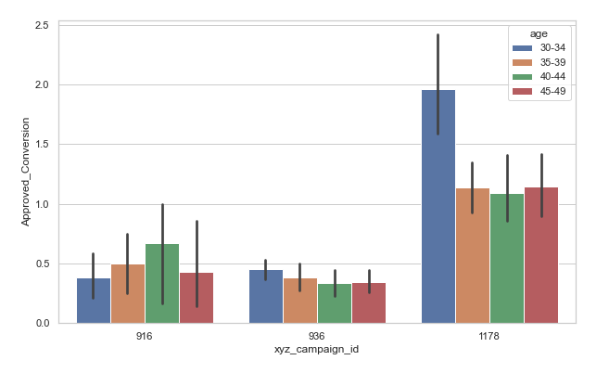
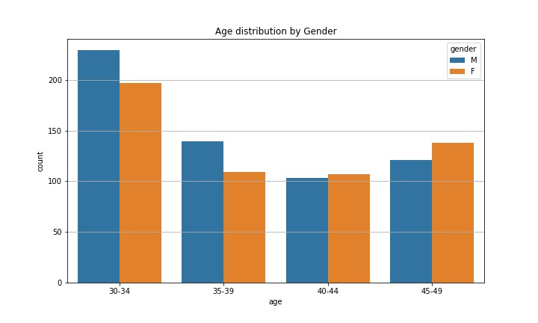
Data Breakdown by Age
The Demographics of of gender and age range. The target demo are evenly split on gender
Which campaign had the most successful purchases. 1176 was the best

Slide 15
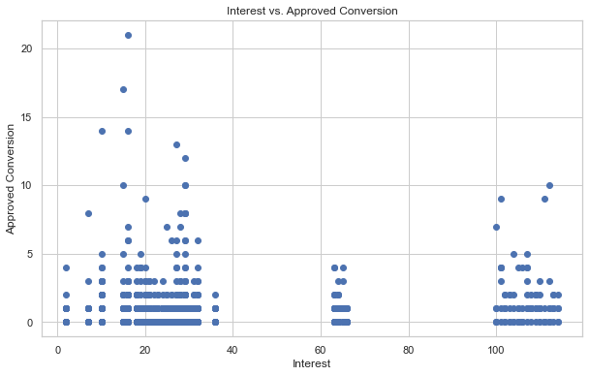
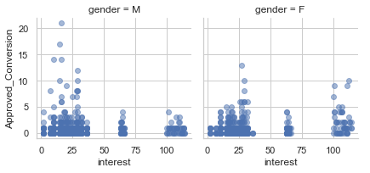
Interest Breakdown
Both gender shows equal interest when purchasing the products
How interested comparison of purchases

Slide 16
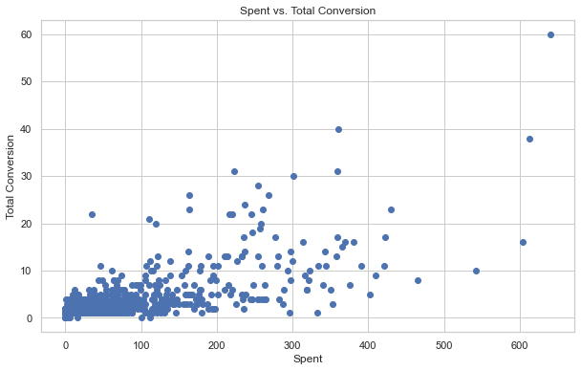
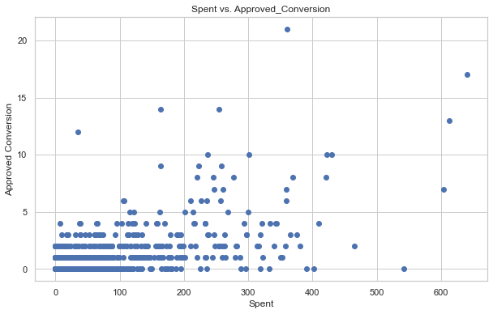
Spent Comparison
As company spends more on promoting the ad it shows more interest in the ads
The more a company spends on ads, the higher chances they have of people making purchases

Slide 17
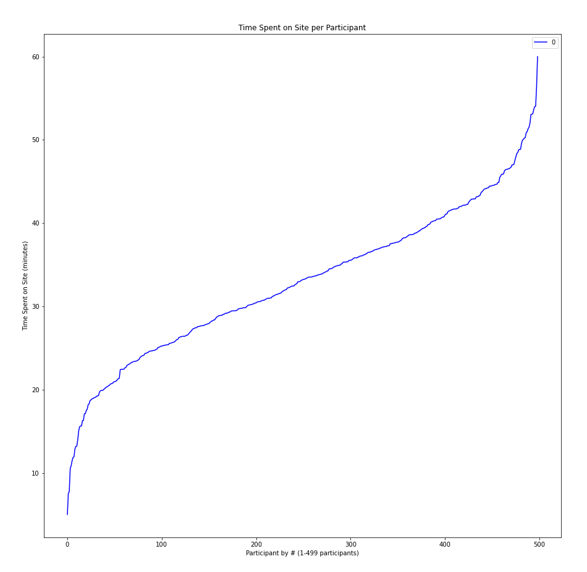
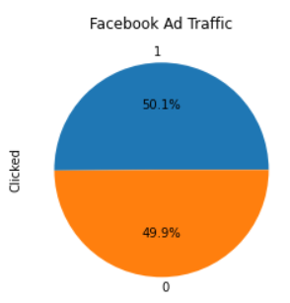
Stephanie’s Discovery
There were 499 participants surveyed and of that about half produced advertisement engagement in the form of ad clicks. The average amount of time spent on Facebook by participants was 32.92 minutes.
Notes:
Another graph that could have been produced had there not been time constraints due to extenuating circumstance would have been a comparison of Time Spent on Site and Click Rates. This graph would have likely been a scatter plot.

Slide 18
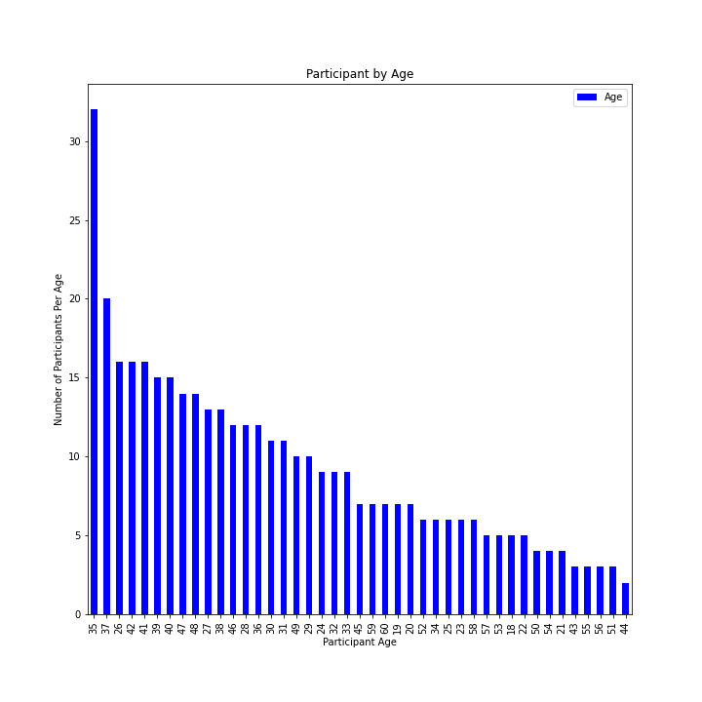
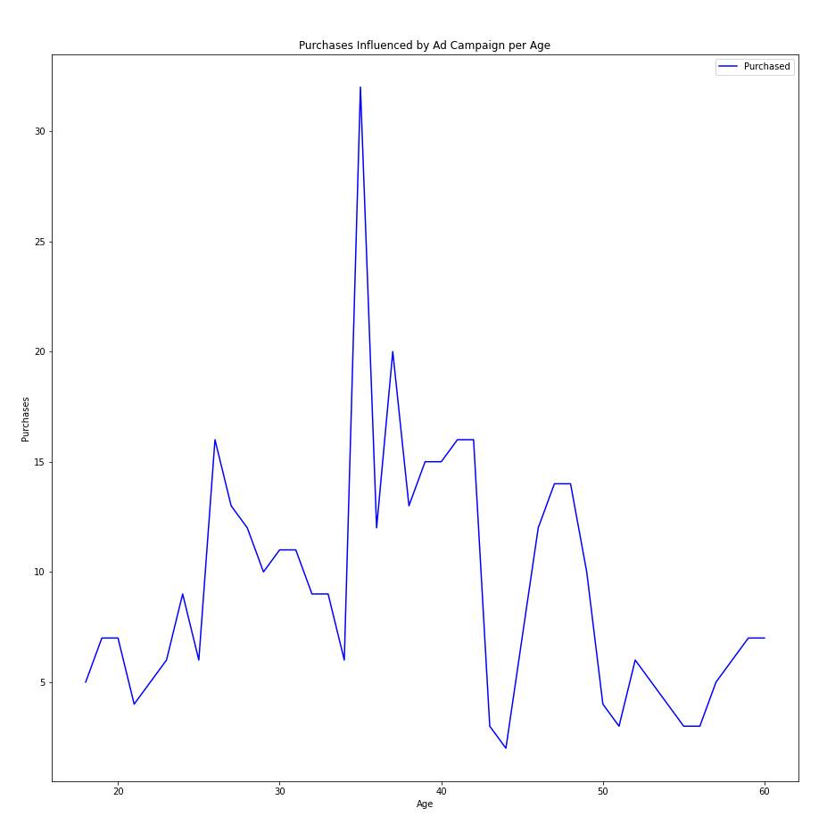
The majority of surveyed participants were 35 years old and the highest rate of purchases was between the ages of 35-40 years indicating a correlation between age and purchase rates.

Slide 19
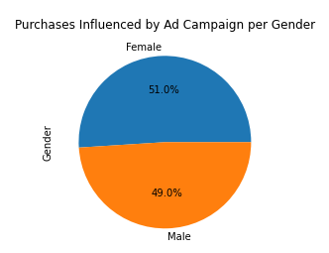
Females show a 2% higher likelihood of purchasing based on social media ad campaigns according to the data produced thru surveyed participants.

Slide 20
Discussion
Most targeted by social media marketing campaigns are individuals of the Gen-Z and Millennial generations
Gender plays little to no role in user engagement.
The more money a company puts into a campaign, the higher rate of return.
Ads on social media platforms are most effective at certain times of day based on who their target demographics are
Notes:
Discuss your findings. Did you find what you expected to find? If not, why not? What inferences or general conclusions can you draw from your analysis?
Our findings suggest that those most targeted by social media marketing campaigns are individuals of the Gen-Z and Millennial generations as initially suspected and gender plays little to no role in user engagement.
Additionally, it is safe to say that the more money a company puts into a campaign the higher rate of return. Our hypothesis was supported and we can confirm that it is possible to define advertisement engagement based on demographics through social media platforms and identify the highest and lowest return rates and economic effect of targeted marketing thru data research and development.

Slide 21
Post Mortem
Difficulties:
Majority of social media data is private to the company and require authorization to receive API of up to two weeks or payment for data utilization.
The generation of an API for a public site such as Twitter is far more tedious than initially thought as the JSON file was so large with a vast array of dictionaries.
Time constraints held us from developing an additional API due to an authorization hold.
Additionally, the Twitter API only allowed for the most recent data to be pulled at once (last 100 instances on specific date/time) and in order to produce larger data quantities the API would have had to have been run for multiple days.
Additional Questions/Time Constraints:
If we had additional time we would continue with our current project and generate more data from the Twitter API as well as generate and develop analytics from Facebook API once authorization was complete.
Notes:
Discuss any difficulties that arose, and how you dealt with them
Discuss any additional questions that came up, but which you didn't have time to answer: What would you research next, if you had two more weeks?

Slide 22
Questions?

